Slide 1



TI FTRC
Advanced Algorithms for THz Sensing and Recognition
Murat Torlak and Yiorgos Makris
University of Texas at Dallas
2019 Annual Review

Slide 2
Static Hand Gesture Recognition
Data Collection and Processing

Slide 3
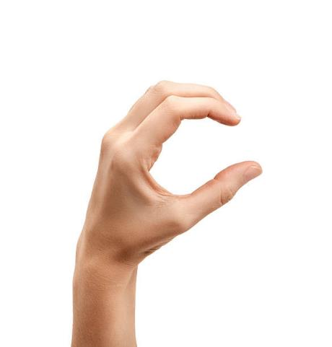
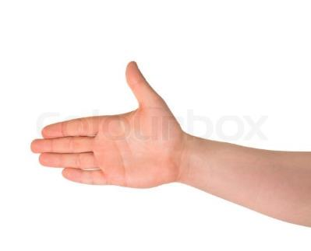
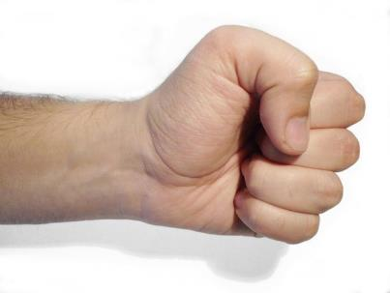

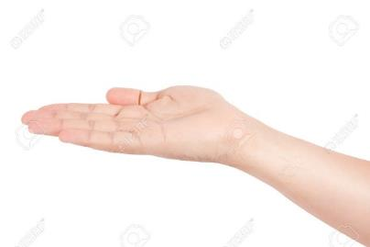

Static Hand Gestures
Fist
C
Palm
Perpendicular (perp)
Thumbs Up (tu)
Two

Slide 4
NEW Static Experiment Parameters
Using TI mmWave radar equipment is set up specifically for hand gesture data collection.
Samples are taken of each hand static gesture from a distance of 0.35m to 0.55m from the radar with a constant, distant background.
Six gestures are used in addition to a ‘none’ gesture (without any hand in the specified range)
Radar Parameters:
3 TX, 4 RX (12 Virtual MIMO Channels)
16bit, Complex1x
Start Frequency: 77GHz New Maximum Range:
Bandwidth: 3.99948GHz R_{max} = 3m
Slope: 99.987 Hz/s
ADC Samples: 64
Sample Rate: 2000 ksps

Slide 5
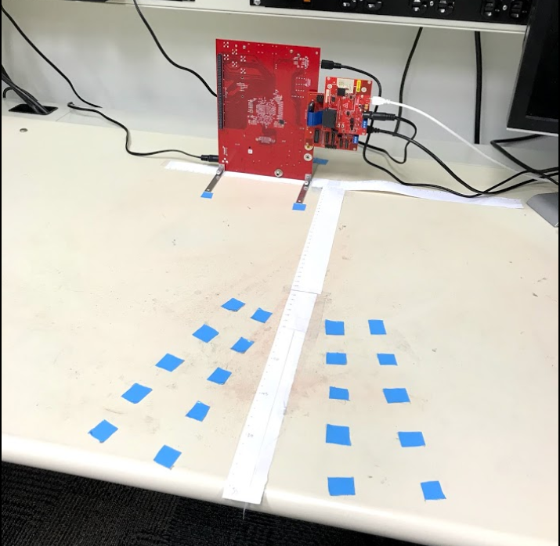
New Setup
Horizontal orientation
25 hand locations
35-55cm range
Increments of 5cm
Azimuth angles of 7°
and 14° on either side
Little to no variation
vertically

Slide 6
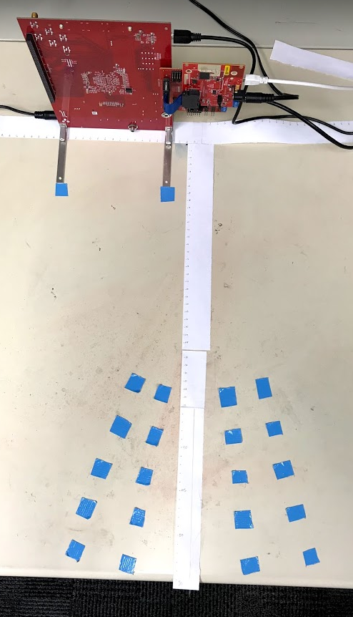
New Setup
As shown below, capture FOV ranges from 35-55cm
across a FOV of
28°, at increments
of 5cm.
Multiple AoA
7°
14°
35cm
7°
55cm
14°
5cm

Slide 7
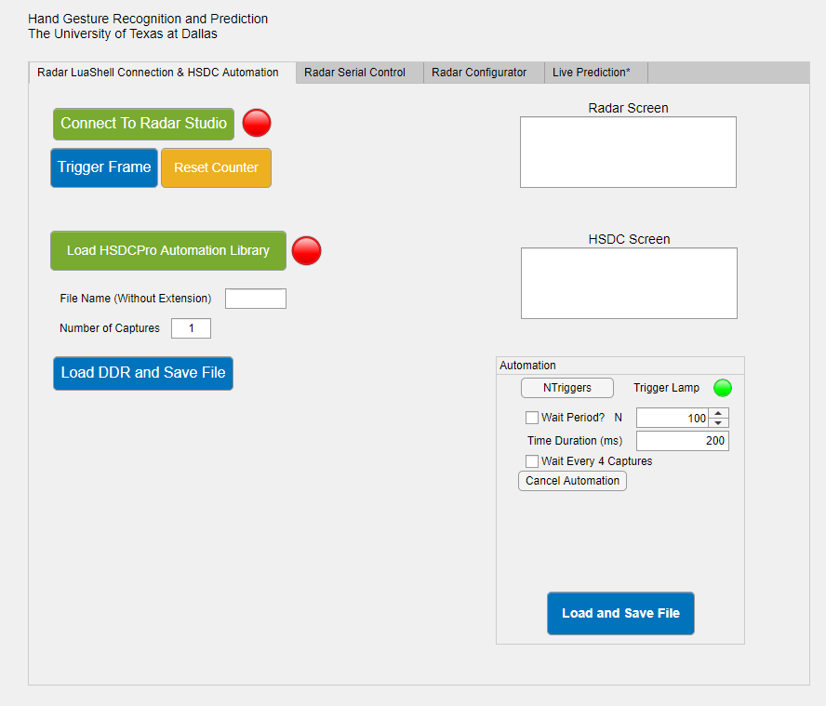
Data Collection

Slide 8
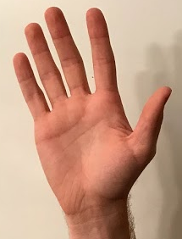
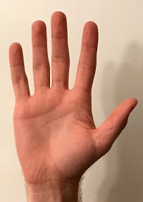
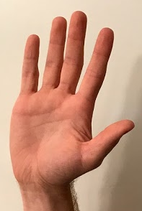
Degrees of Freedom
30° of rotation in each direction
Side to side
Forward and backward
Left and right
Different hands used (different reflectivity etc.)
30°
30°

Slide 9
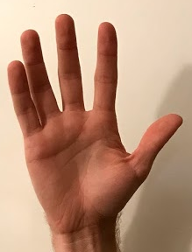
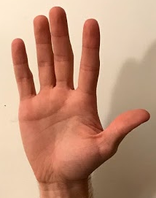
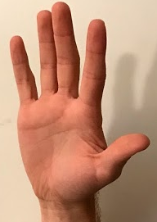
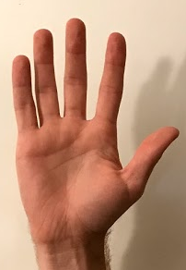
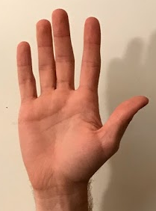
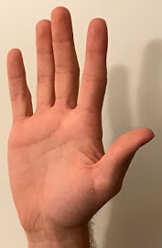
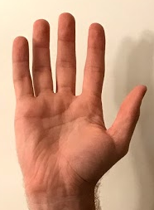
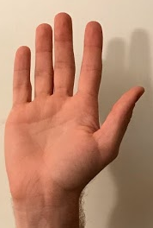
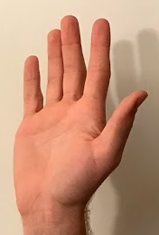
Degrees of Freedom
30°
30°
30°
30°

Slide 10
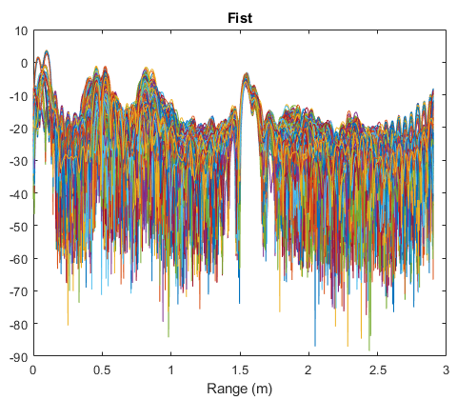
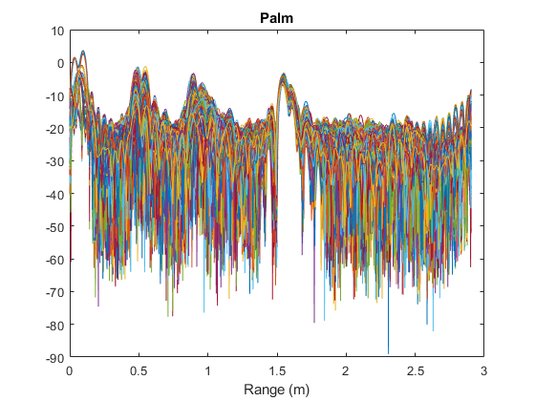
New Raw Range Data

Slide 11
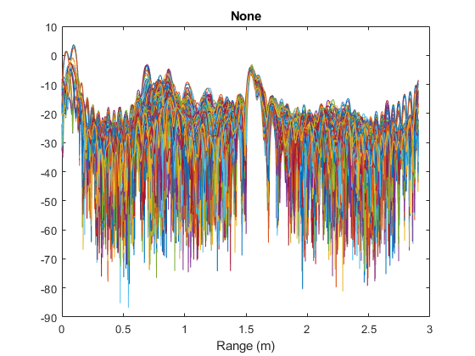
New Raw Range Data

Slide 12



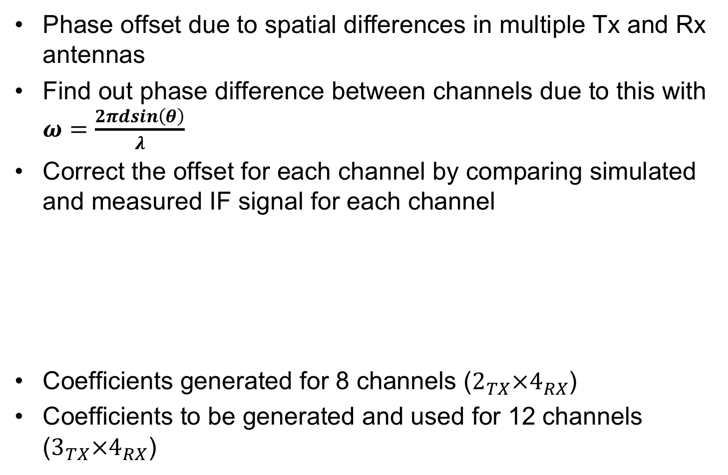

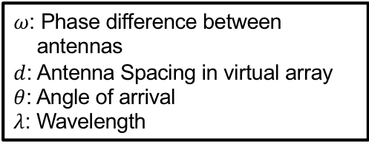




Calibration
Phase offset due to spatial differences in multiple Tx and Rx antennas
Find out phase difference between channels due to this with $ω=\frac{2πdsin\left(θ\right)}{λ}$
Correct the offset for each channel by comparing simulated and measured IF signal for each channel
Coefficients generated for 8 channels ($2_{TX}×4_{RX}$)
Coefficients to be generated and used for 12 channels ($3_{TX}×4_{RX}$)
$ω$: Phase difference between
antennas
$d$: Antenna Spacing in virtual array
$θ$: Angle of arrival
$λ$: Wavelength
$$θ$$
$$dsin(θ)$$
$$θ$$
C1
$$d$$
C2
C3
…
Cn
$$0$$
$$ω$$
$$2ω$$
$$(n−1)ω$$

Slide 13
Preprocessing Techniques
Optimize Range FFT size
Find optimal number of features from which machine learning algorithm can distinguish
Normalized to zero mean and unit variance
Dataset 1: Small dataset with 600 captures, no range or angle variation, high resolution (3Tx – 12 Channels): 95.45%
Dataset 2: Large dataset with 24,000 captures, increased variation, high resolution (3Tx – 12 Channels): 51.85%
When gesture is close to the body, a shadow from the body buries the gesture
Introduction of many variables (range/angle) stretches the limits of our current preprocessing techniques
Control/Minimal Preprocessing

Slide 14
Range FFT Format
R1 | R2
Rn
...
Channel 1
Channel 2
Channel 3
Channel 4
Channel 5
Channel 6
Channel 7
Channel 8
Channel 9
Channel 10
Channel 11
Channel 12
Range FFT produces a 12 x n array with 12 virtual channels and n range bins
...
...

Slide 15
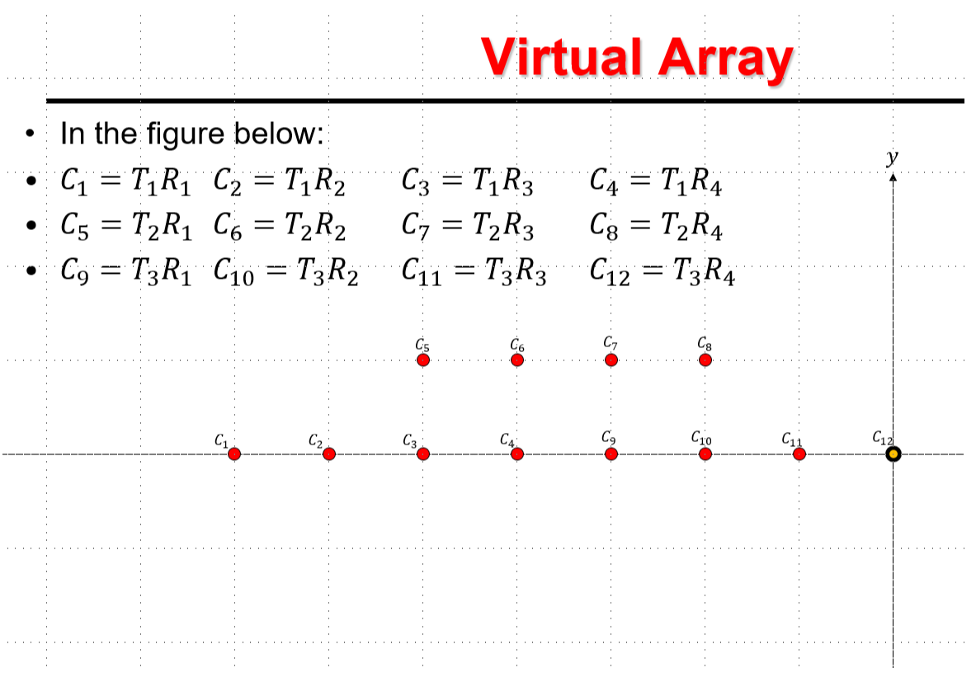

Slide 16
Reformatting Range FFT
Reformatted Range FFT to align with virtual array produces array of size 8 x n x 2
R1 | R2
Rn
Channel 1
Channel 2
Channel 3
Channel 4
Channel 9
Channel 10
Channel 11
Channel 12
Zero Pad
Zero Pad
Channel 5
Channel 6
Channel 7
Channel 8
Zero Pad
Zero Pad
...
...
Accuracy: 97.98%
Notes:
Make slide about real/complex layering of machine learning network

Slide 17
2D Range-Angle FFT
After Range-FFT, another FFT is performed across the sensor dimension to produce the Range-Angle FFT.
The angle domain shows a peak at the azimuth angle of arrival for returning chirp signals.
We will consider a region of the Angle-Range FFT in which we expect the gesture to appear.
R1 | R2
Dimension 1
...
Dimension 2
...
Accuracy: 95.96%

Slide 18
Network Complex Layering
Input layer to the convolutional neural network
With Range FFT data, input image is of size n x 12 x 2
Current constraints limit the dimensions of the input layer for the Range-Angle FFT to n x 8 x 4
n = number of range bins
R1 | R2
Real Part
...
Imaginary Part
...

Slide 19
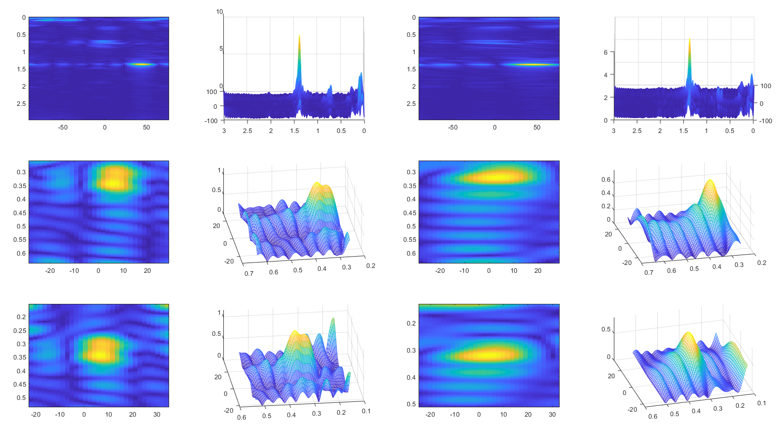
Range-Angle FFT Peak Alignment
Dimension 1
Dimension 2
Notes:
We locate the peak in the region which we expect to contain the gesture, then we select a window surrounding that peak

Slide 20
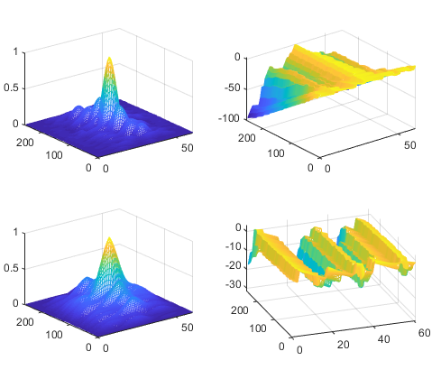
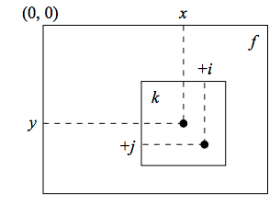
2D Autocorrelation
2D Autocorrelation
Common peak location among all instances
Resolves spatial differences from gesture types
Possibly infeasible moving forward
Accuracy: 84.85%

Slide 21
Conclusion
Progress towards high accuracy systems
Developing synergy between data collection, preprocessing, and machine learning
Data Collection
Start with constant range
Each dataset includes more variation
Time-Frequency Analysis (STFT)
Future Work

